Slide 1

First Technical Workshop on Standards for Hazard Monitoring, Data, Metadata and Analysis to Support Risk Assessment
WMO
Session 4: Activities of WMO Technical Programmes for Development of Guidelines, Manuals
and Standards for Monitoring, Detection, Development of Databases, Metadata and
Hazard Analysis to Support Risk Assessment
Tropical Cyclone Programme
Andrew Burton A.Burton@bom.gov.au
Hazard/Risk Workshop 10-14 June 2013 WMO Geneva, Switzerland
Notes:
Background information.

Slide 2
Tropical Cyclone Programme
Definitions of tropical cyclone.
Complexity of tropical cyclones in relation to the chain of associated hazards
Monitoring and observational network for tropical cyclones
Historical data bases of tropical cyclones
Historical analysis of tropical cyclone characteristics.
Forecasting tools/models and methodologies
Hazard/Risk Workshop 10-14 June 2013 WMO Geneva, Switzerland

Slide 3
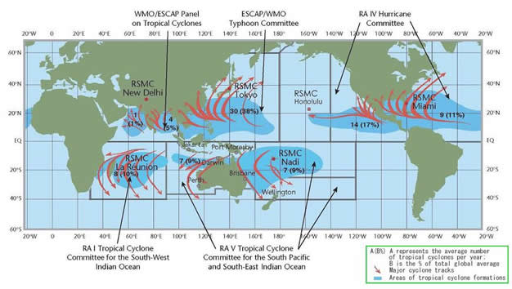
Tropical Cyclone Programme
Forecasting and monitoring centres
10-14 June 2013 WMO Geneva, Switzerland
Notes:
3

Slide 4
Tropical Cyclone Programme
Defining Tropical Cyclone
“Generic term for a warm-core non-frontal synoptic scale cyclone originating over tropical or sub-tropical waters with organized deep convection and closed cyclonic surface wind circulation.
The term is also used for a storm in the South-West Indian Ocean in which the maximum sustained wind speed is estimated to be in the range of 64 to 89 knots and in the South Pacific and South-East Indian Ocean with the maximum sustained surface wind speed greater than 33 knots.” (WMO 2012a)
10-14 June 2013 WMO Geneva, Switzerland
Notes:
Does this definition have any relevance to risk assessment? Does it matter as long as everyone uses the same definition?
Tropical Cyclone vs post tropical cyclone: is this important?
4

Slide 5
Tropical Cyclone Programme
Defining Tropical Cyclone: Variations
Some agencies adopt definitions that comply with their Regional Association’s definition but add extra requirements.
Eg. BoM: “…the maximum mean wind speed of 34 knots or greater must extend more than half-way around near the centre and persist for at least six hours.”
Implication: different TC counts depending on the database you use.
10-14 June 2013 WMO Geneva, Switzerland
Notes:
But once we have it as a tropical cyclone we define the intensity by the maximum wind speed anywhere in the system, well, providing it isn’t from a tornado or mesovortex.
5

Slide 6
Tropical Cyclone Programme
Defining Tropical Cyclone: Variations
10-14 June 2013 WMO Geneva, Switzerland
Notes:
Different terminology same thresholds…..sadly no.
6

Slide 7
Tropical Cyclone Programme
Defining Tropical Cyclone: Variations
Intensity defined by wind – a problematic parameter
Turbulence properties: speed dependent on averaging period.
Mean wind vs gusts
Dependence on exposure and small scale factors.
Wind standards can kill tropical cyclones.
10-14 June 2013 WMO Geneva, Switzerland
Notes:
Christopher Strager’s comments on storm surge importance and on fetch. Importance of structure over max wind speed.
7

Slide 8
Tropical Cyclone Programme
Tropical Cyclone: Associated Hazards
UNISDR definition:
“Hydrometeorological hazard
Process or phenomenon of atmospheric, hydrological or oceanographic nature that may cause loss of life, injury or other health impacts, property damage, loss of livelihoods and services, social and economic disruption, or environmental damage.
Comment: Hydrometeorological hazards include tropical cyclones … coastal storm surges, floods including flash floods, … “
10-14 June 2013 WMO Geneva, Switzerland
Notes:
8

Slide 9
Tropical Cyclone Programme
Tropical Cyclone: Associated Hazards
TC databases typically do not address the associated “sub-hazards”
Storm surge is (most?) often not measured.
Flood from tropical low vs flood from TC. Does it matter?
Complex causality of floods.
Remote hazards – eg tornadoes, landslides
10-14 June 2013 WMO Geneva, Switzerland
Notes:
TC databases maintained by RSMCs who often cannot measure storm surge (for example)
Possible recommendations: NMHSs should endeavour to measure storm tide and storm surge for all TC impacts.
EAG to develop guidelines on what associated hazards should be stored in TC databases. Should NMHSs keep separate databases for each subhazard
9

Slide 10
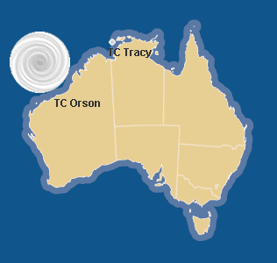
Tropical Cyclone Programme
Size matters

Slide 11
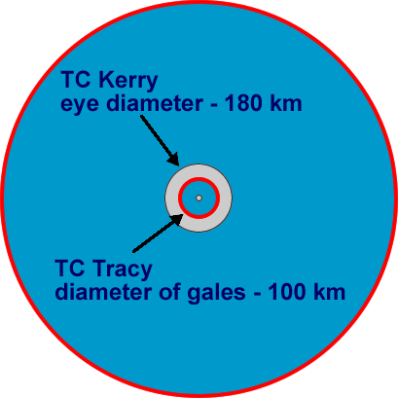
“Available in a range of shapes and sizes”
Notes:
Size can be assessed in terms of the radius of gales (or storm or hurricane force winds) or the inner core and eye.
Kerry (21 Feb 1979, Coral Sea) had an eye diameter of 180 km compared to Tracey’s 12km. Tracey while still intense (Cat 4) only had a radius of gales of 50km.
Kerry radius gales = ? Eye diameter = 180 km
Tracy radius gales = 50 km, eye diameter = 12 km
Hurricane Wilma (2005) (Very intense (Saffir-Simpson Cat 5)) had an eye DIAMETER of 5km
Rosita eye diameter ~15km, radius gales = 70km
Orson radius gales = 470km
Vance radius of gales = 200km
John radius of gales = 250km
For severe TCs the radius of destructive winds is much less than the radius of gales. Typical values are 20-50 km compared to gale radius of well over 100km. The larger systems have the greater potential for storm surge and swell waves, and also rainfall.
Super Typhoon Tip 1979 West Pacific not only did it have a record 870hPa central pressure but also extended across a huge area with gales over 1000km radius compared to Tracey that while still intense (Cat 4) only had a radius of gales of 50km.
Off NW Australia compare Rosita to Orson.
Strongest:Pressure Gradient: 5.5 hPa km-1 measured over 2 km in Tropical Cyclone Tracy, Darwin, Australia, December 24 1974 (Bureau of Meteorology, 1975). Also 5 hPa km-1 in Hurricane Inez, North Atlantic, 28 September 1966 (Hawkins and Imbembo, 1976).

Slide 12
Tropical Cyclone Programme
Observation networks
High level of dependence on satellites.
Consequence: brevity of useful historical TC record
Observing networks can affect paradigms.
10-14 June 2013 WMO Geneva, Switzerland
Notes:
12

Slide 13
Tropical Cyclone Programme
Historical databases
Maintained by RSMCs, TCWCs
IBTrACS commenced 2009 – “a game changer”
All best track data provided to IBTrACS
Global coverage, standardisation.
IBTrACS team deal with different formats from the agencies.
10-14 June 2013 WMO Geneva, Switzerland
Notes:
13

Slide 14


Parameter summary
2nd IBTrACS Workshop
11-13 April 2011
14
From all agencies
  Time, Latitude, longitude
  Wind & Pressure
  Cyclone type
From some agencies
  Wind radii (5)
  Radius of Maximum Winds (4)
  Radius of outermost closed isobar (3)
  Pressure of outermost closed isobar (2)
  Dvorak Parameters: T-number and CI (2)
Notes:
Thanks to Ken Knapp for this slide, taken from 2nd IBTrACS Workshop presentation

Slide 15
Tropical Cyclone Programme
Size matters

Slide 16
“Available in a range of shapes and sizes”
Notes:
Size can be assessed in terms of the radius of gales (or storm or hurricane force winds) or the inner core and eye.
Kerry (21 Feb 1979, Coral Sea) had an eye diameter of 180 km compared to Tracey’s 12km. Tracey while still intense (Cat 4) only had a radius of gales of 50km.
Kerry radius gales = ? Eye diameter = 180 km
Tracy radius gales = 50 km, eye diameter = 12 km
Hurricane Wilma (2005) (Very intense (Saffir-Simpson Cat 5)) had an eye DIAMETER of 5km
Rosita eye diameter ~15km, radius gales = 70km
Orson radius gales = 470km
Vance radius of gales = 200km
John radius of gales = 250km
For severe TCs the radius of destructive winds is much less than the radius of gales. Typical values are 20-50 km compared to gale radius of well over 100km. The larger systems have the greater potential for storm surge and swell waves, and also rainfall.
Super Typhoon Tip 1979 West Pacific not only did it have a record 870hPa central pressure but also extended across a huge area with gales over 1000km radius compared to Tracey that while still intense (Cat 4) only had a radius of gales of 50km.
Off NW Australia compare Rosita to Orson.
Strongest:Pressure Gradient: 5.5 hPa km-1 measured over 2 km in Tropical Cyclone Tracy, Darwin, Australia, December 24 1974 (Bureau of Meteorology, 1975). Also 5 hPa km-1 in Hurricane Inez, North Atlantic, 28 September 1966 (Hawkins and Imbembo, 1976).

Slide 17
Best Track formats
NCDC TD-9636
149991989101016121320109453019210 0202519 0081471 0
150001989101016181338109383019318 015 999 1 01
150011989111128121171108401517219 025 999 0 0
JMA
66666 0822 031 0030 0822 0 6 DOLPHIN 20090116
08121106 002 2 125 1452 1000 000
08121112 002 2 128 1436 1002 000
08121118 002 2 130 1423 1000 000
BoM
1,614,1906,1,,S,,190701172300,,,,130,1465,,994,,,WW,,,,,,,,,,,,,,,,,,,,,,,,,20,11,1907,1,17,23,0,01/17/1907 23:00:00,,,,3690.00000000524,6244
2,614,1906,1,,S,,190701182300,,,,150,1450,,993,,,WL,,,,,,,,,,,,,,,,,,,,,,,,,27,13,1907,1,18,23,0,01/18/1907 23:00:00,1440,,,2520,21118
3,614,1906,1,,S,,190701192300,,,,140,1430,,993,,,LL,,,,,,,,,,,,,,,,,,,,,,,,,30,4,1907,1,19,23,0,01/19/1907 23:00:00,1440,,,2160,2282
CPHC
2003 TROPICAL DEPRESSION 01-C,,,,,,,,,
08/15 / 1800,13.6,151,1009,30,,,,,
16 / 0000,13.9,152.9,1009,30,",,,,
16 / 0600,14.2,154.4,1009,30,",,,,
CMA/STI
66666 0000 32 0025 0822 0 6 Dolphin 20090418
2008121100 1 125 1471 1002 15
2008121106 1 126 1450 1002 15
2008121112 1 128 1433 1002 15
IMD
04/05/1990,0000, 8.5,87.0,1.0,1006, 16, 2,,1006,7,
04/05/1990,0600, 8.5,87.0,1.5,1002, 25, 4,,1006,10,
04/05/1990,1200, 9.5,87.0,1.5,1000, 25, 4,,1004,5,
Reunion – Old Format
xxxx84800118480301062114 2 755 999999911099999904
xxxx84800118480302062117 2 740 999999911099999904
xxxx84800118480303062144 2 646 999999911099999904
Reunion – New WMO Format
11SWI20061520062007200704091222171020369182101001511002099101092999599999999999999999994999999999999999999940104
11SWI20061520062007200704091822191220380112101001511002099100992999599999999999999999994999999999999999999940104
11SWI20061520062007200704100022240820390121151502011003099100892999599999999999999999994999999999999999999940204
HKO
TCNAME YYYYMMDDHH(UTC) INTENSITY …
RITA 1961011406 TD 79 1355 1003 25
RITA 1961011412 TD 82 1343 1002 25
RITA 1961011418 TD 88 1334 1001 25
Neumann, HURDAT
00005T07/15/1960 M= 7 1 SNBR= 1 HSK0161 BSH0161 JTWC&NCDC
00010 07/15 * 60 970T 25E * 66 964T 25E
00015 07/16* 72 958T 20E * 78 951T 20E * 85 945T 25E * 93 939T 25E
00020 07/17*102 934T 25E *113 929T 25E *125 925T 25E *149 925T 25E
00025 07/18*173 930T 30E *192 936T 30E *210 945T 30E *234 961T 30E
Nadi
NAME YYYY MM DD HHHH LAT LONG PRES W(KT) Catergory
=========================++++++++++++=======================
DAMAN 2007 12 03 0000 12.0 -174.5 1004 15 Tropical Depression (TD) Phase
DAMAN 2007 12 03 0600 12.1 -175.0 1004 15
DAMAN 2007 12 03 1200 12.3 -175.5 1004 15
JTWC – ATCF format
WP, 12, 2008081218, , BEST, 0, 224N, 1343E, 15, 1010, DB, 0, , 0, 0, 0, 0,
WP, 12, 2008081300, , BEST, 0, 226N, 1335E, 15, 1010, DB, 0, , 0, 0, 0, 0,
WP, 12, 2008081306, , BEST, 0, 231N, 1328E, 15, 1006, DB, 0, , 0, 0, 0, 0, 1009, 150, 25, 0, 0, W, 0, , 0, 0, INVEST, S,
WP, 12, 2008081312, , BEST, 0, 237N, 1325E, 15, 1006, DB, 0, , 0, 0, 0, 0, 1009, 150, 25, 0, 0, W, 0, , 0, 0, INVEST, S,
Wellington
Name,Year,Month,Day,Time,Lat,Lon,PPP,Max,Prog
GISELE,1968,4,3,0000,8,156.4,1002,25,H+000
GISELE,1968,4,3,1200,7.4,157.6,1002,25,H+000
GISELE,1968,4,4,0000,7,159,1002,25,H+000
Diamond
HD-1986-04,1986-03-05T00:00:00.0, -18.7455, 173.0290, 1
HD-1986-04,1986-03-05T00:00:00.0, -19.0438, 173.3770, 2
HD-1986-04,1986-03-05T00:00:00.0, -19.3420, 173.7240, 3
Notes:
Thanks to Ken Knapp for this slide, taken from 2nd IBTrACS Workshop presentation

Slide 18

IBTrACS Workshop recommendations
Best tracking agencies should …
  Report more parameters and use WMO format
  Document current and historic BT practices
  Standardize definitions of winds and wind conversions
  Rescue and archive documents relevant to BT data
  “Best track” throughout life cycle (through ET)
  Encourage best track data discussions at IWTC
2nd IBTrACS Workshop
11-13 April 2011
18
Notes:
Thanks to Ken Knapp for this slide, taken from 2nd IBTrACS Workshop presentation

Slide 19
Tropical Cyclone Programme
Historical databases
TC “spurs” and “mergers”
Spur?
Merger?
10-14 June 2013 WMO Geneva, Switzerland
Notes:
19

Slide 20
Tropical Cyclone Programme
Historical databases
Historical Databases (DB) – one size does not fit all
DB for climate analysis – requires homogeneity
DB for engineering – capture the extremes
Pressure in the historical databases – not a normalised parameter.
Biases in TC databases due to analysis techniques
10-14 June 2013 WMO Geneva, Switzerland
Notes:
20

Slide 21
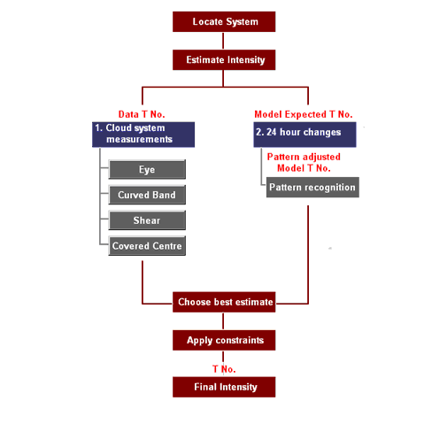
Tropical Cyclone Programme
Analysis techniques
Analysis of TC characteristics
Prior to the satellite era – unreliable, incomplete.
Dvorak technique – the foundation of TC databases
10-14 June 2013 WMO Geneva, Switzerland
Notes:
21

Slide 22
Tropical Cyclone Programme
Analysis techniques
Dvorak Technique
1. Determine CI
2. Map CI to wind
3. Map wind to pressure
10-14 June 2013 WMO Geneva, Switzerland
Notes:
22

Slide 23
Tropical Cyclone Programme
Analysis techniques
International Workshop on the Satellite Analysis of Tropical Cyclones (IWSATC)
Documenting variations in the Dvorak technique:
  over time
  across agencies
Looking for sources of systematic bias:
  due to variations in application of the technique
  due to use of different CI->wind->pressure relationships
10-14 June 2013 WMO Geneva, Switzerland
Notes:
23

Slide 24
Tropical Cyclone Programme
Forecasting tools and methodologies
Track forecasting – well defined process, consensus forecasting.
Intensity forecasting – on the threshold of a breakthrough?
Structure – not well measured, forecast or verified
10-14 June 2013 WMO Geneva, Switzerland
Notes:
24

Slide 25
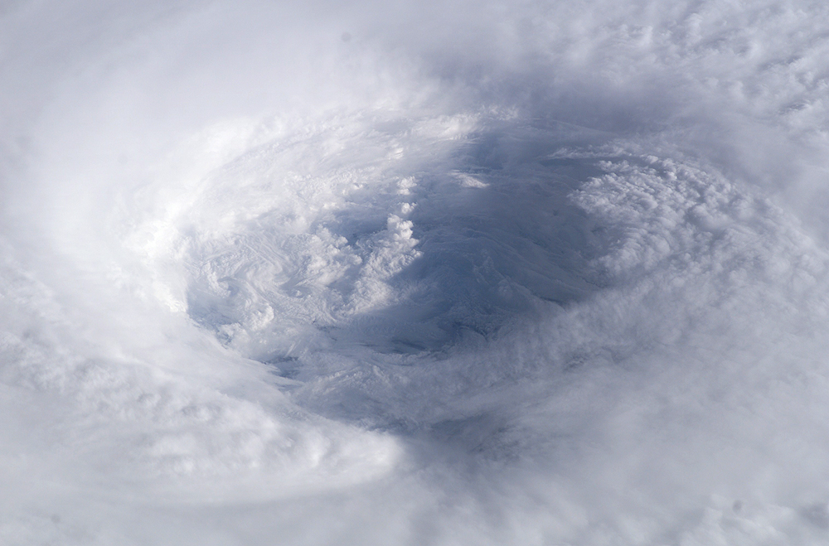
Tropical Cyclone Programme
Variation
Thank you
10-14 June 2013 WMO Geneva, Switzerland
Notes:
25

Slide 26
Tropical Cyclone Programme
text
10-14 June 2013 WMO Geneva, Switzerland
Notes:
26

